Slide 1

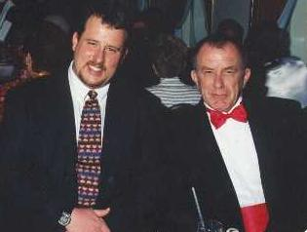
Exposure CS 2021
for CS1-Honors
Chapter 18 Slides
More Graphics:
Events & Computer Animation
PowerPoint Presentation
created by:
Mr. John L. M. Schram
and Mr. Leon Schram
Authors of Exposure
Computer Science

Slide 2
Section 18.1
Introduction

Slide 3
The Last Chapter is Special!
In this chapter you will learn more advanced graphics features. These features will not be as advanced as those taught in AP® Computer Science-A or Advanced Graphics, but they still will allow you to create more impressive graphics programs.
There will be no homework exercises for this chapter. There will also be no quizzes and no test. The information covered in this chapter will not even be part of the Final Exam. However, there are 2 lab assignments – 1 minor lab and 1 major lab – that are based on the information in this chapter. At John Paul II High School the major lab counts as the 4th Quarter Project.

Slide 4
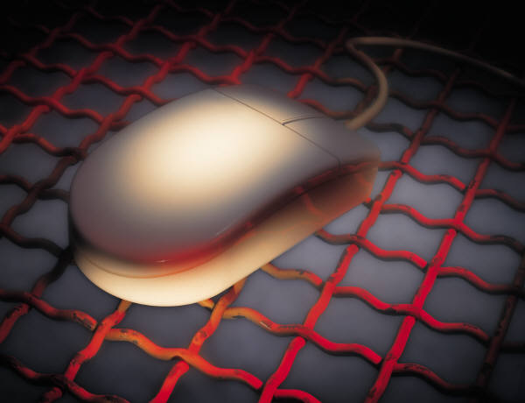
Section 18.2
Mouse Events

Slide 5
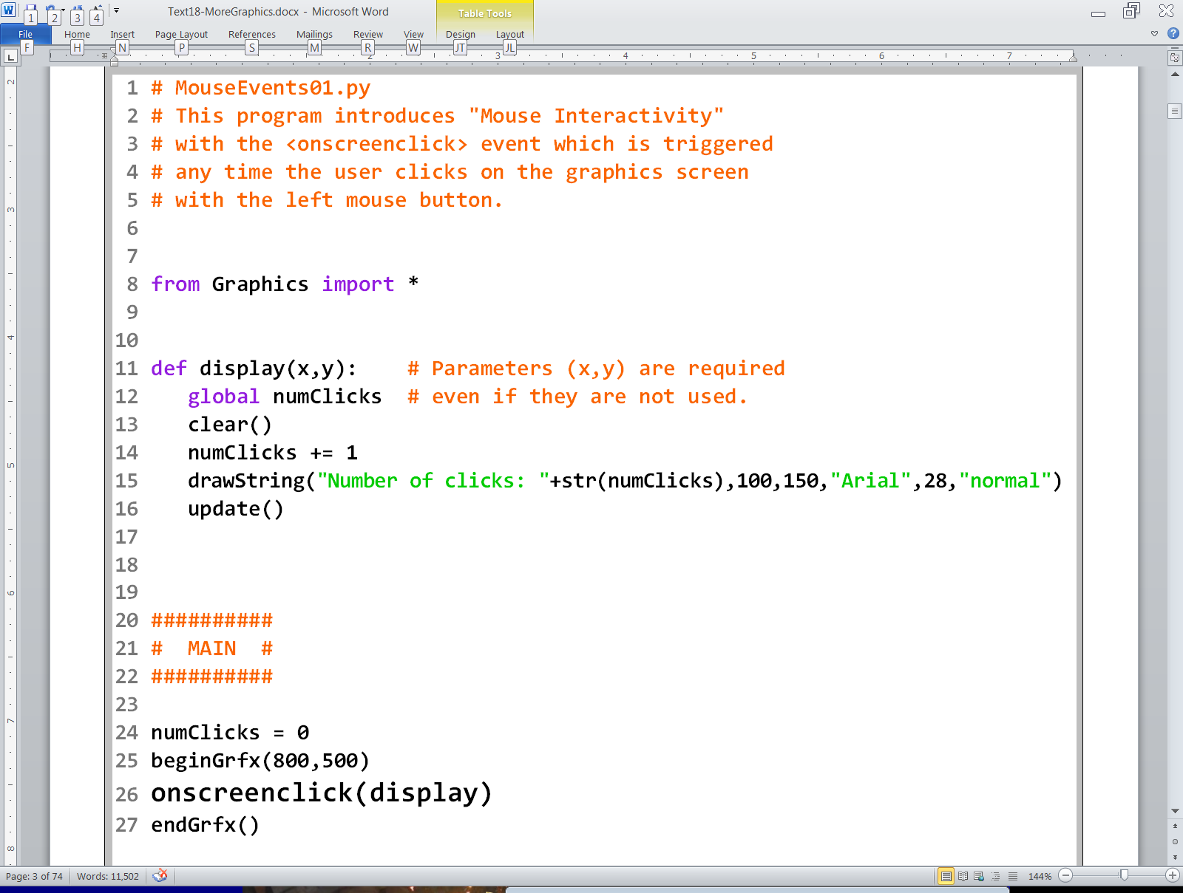

Slide 6
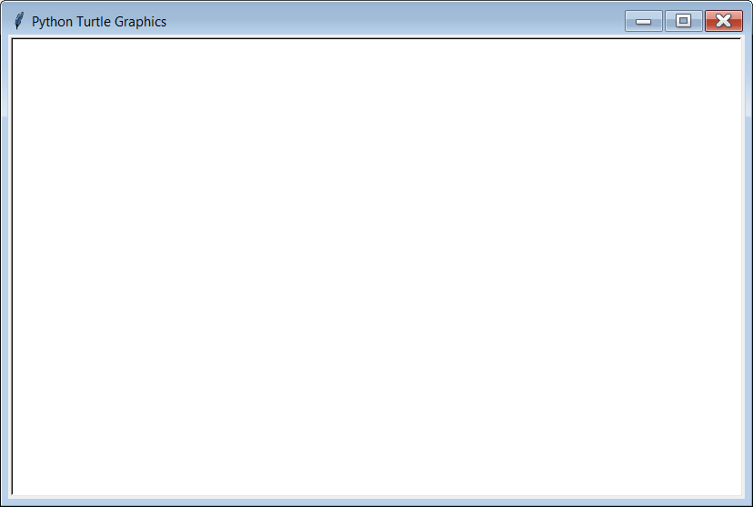
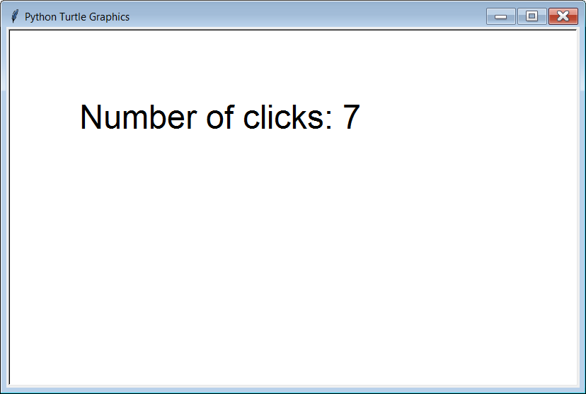
Initial Output
7 clicks later

Slide 7
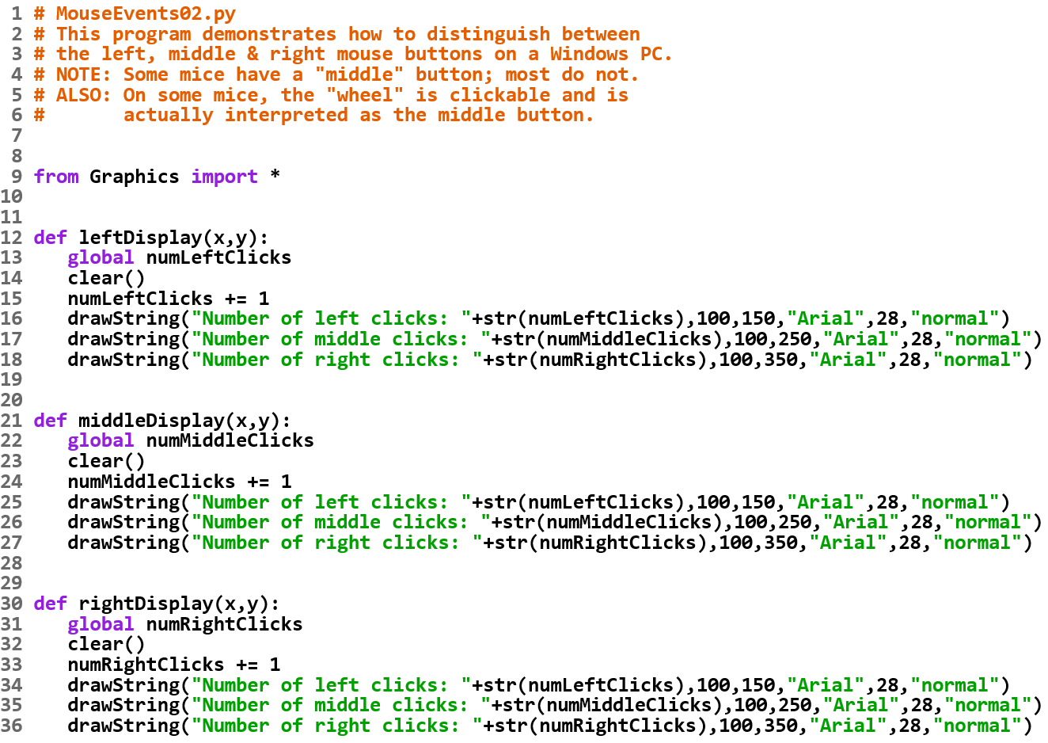

Slide 8
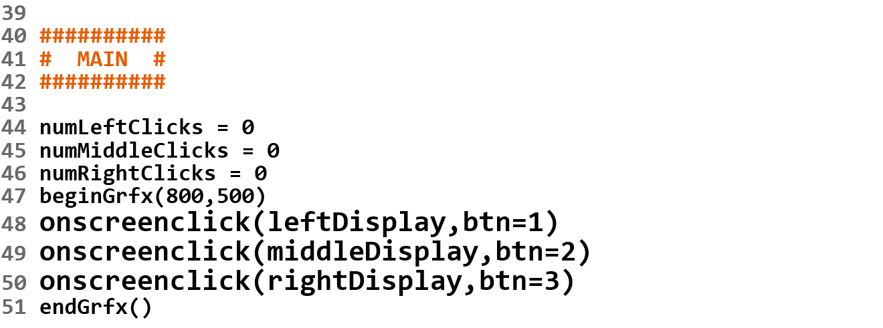
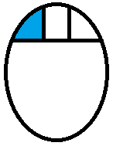
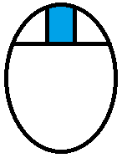
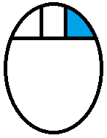
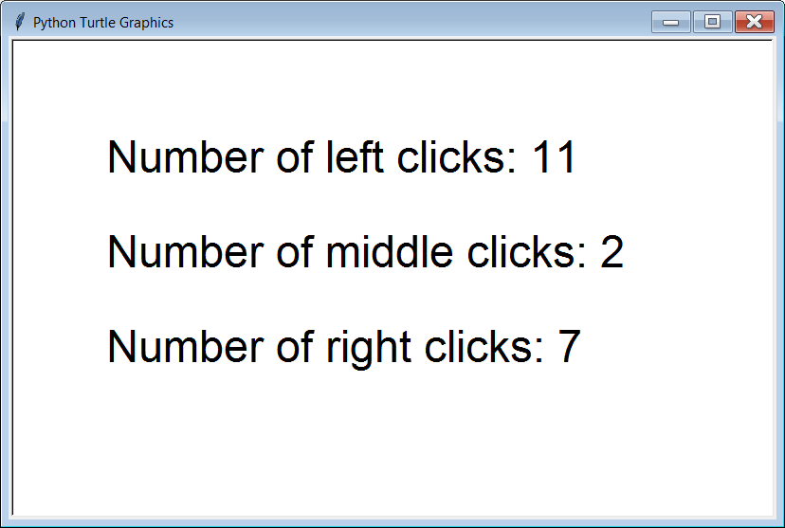
NOTE: On some mice the wheel is clickable and acts as the middle button.
Initial Output

Slide 9
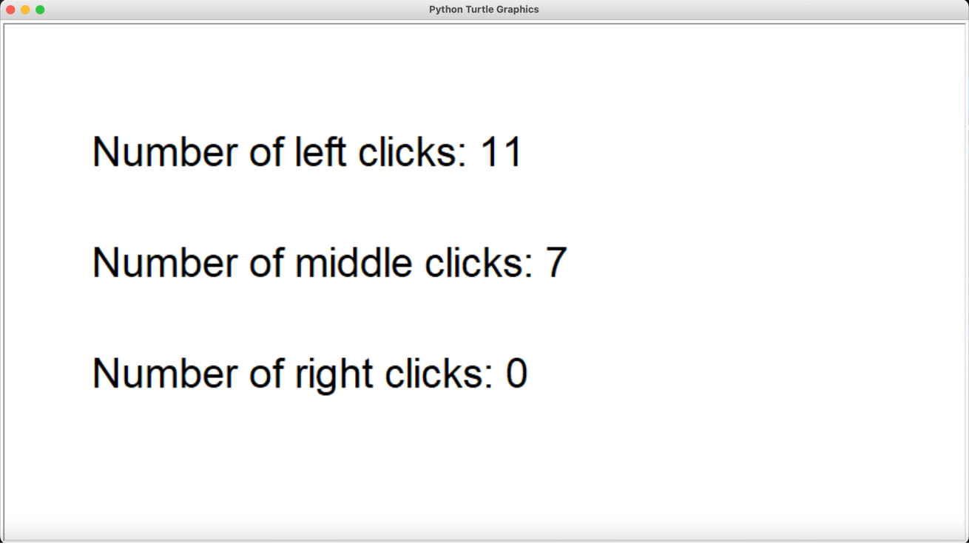
ALSO: If you run this program on a Mac, and right/2-finger click 7 times, you get this output. Since Macs don’t have any type of “middle-click” they use a button value of 2 for right/2-finger click.

Slide 10
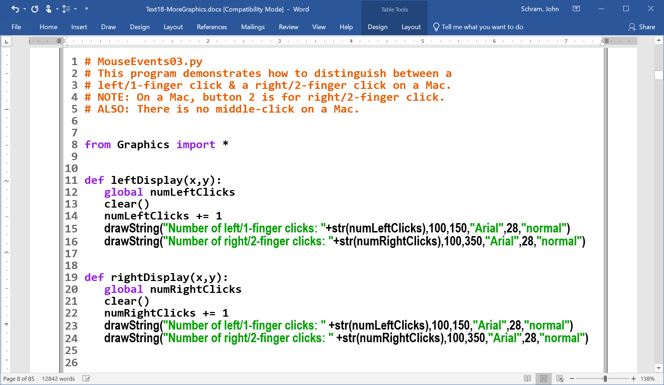

Slide 11
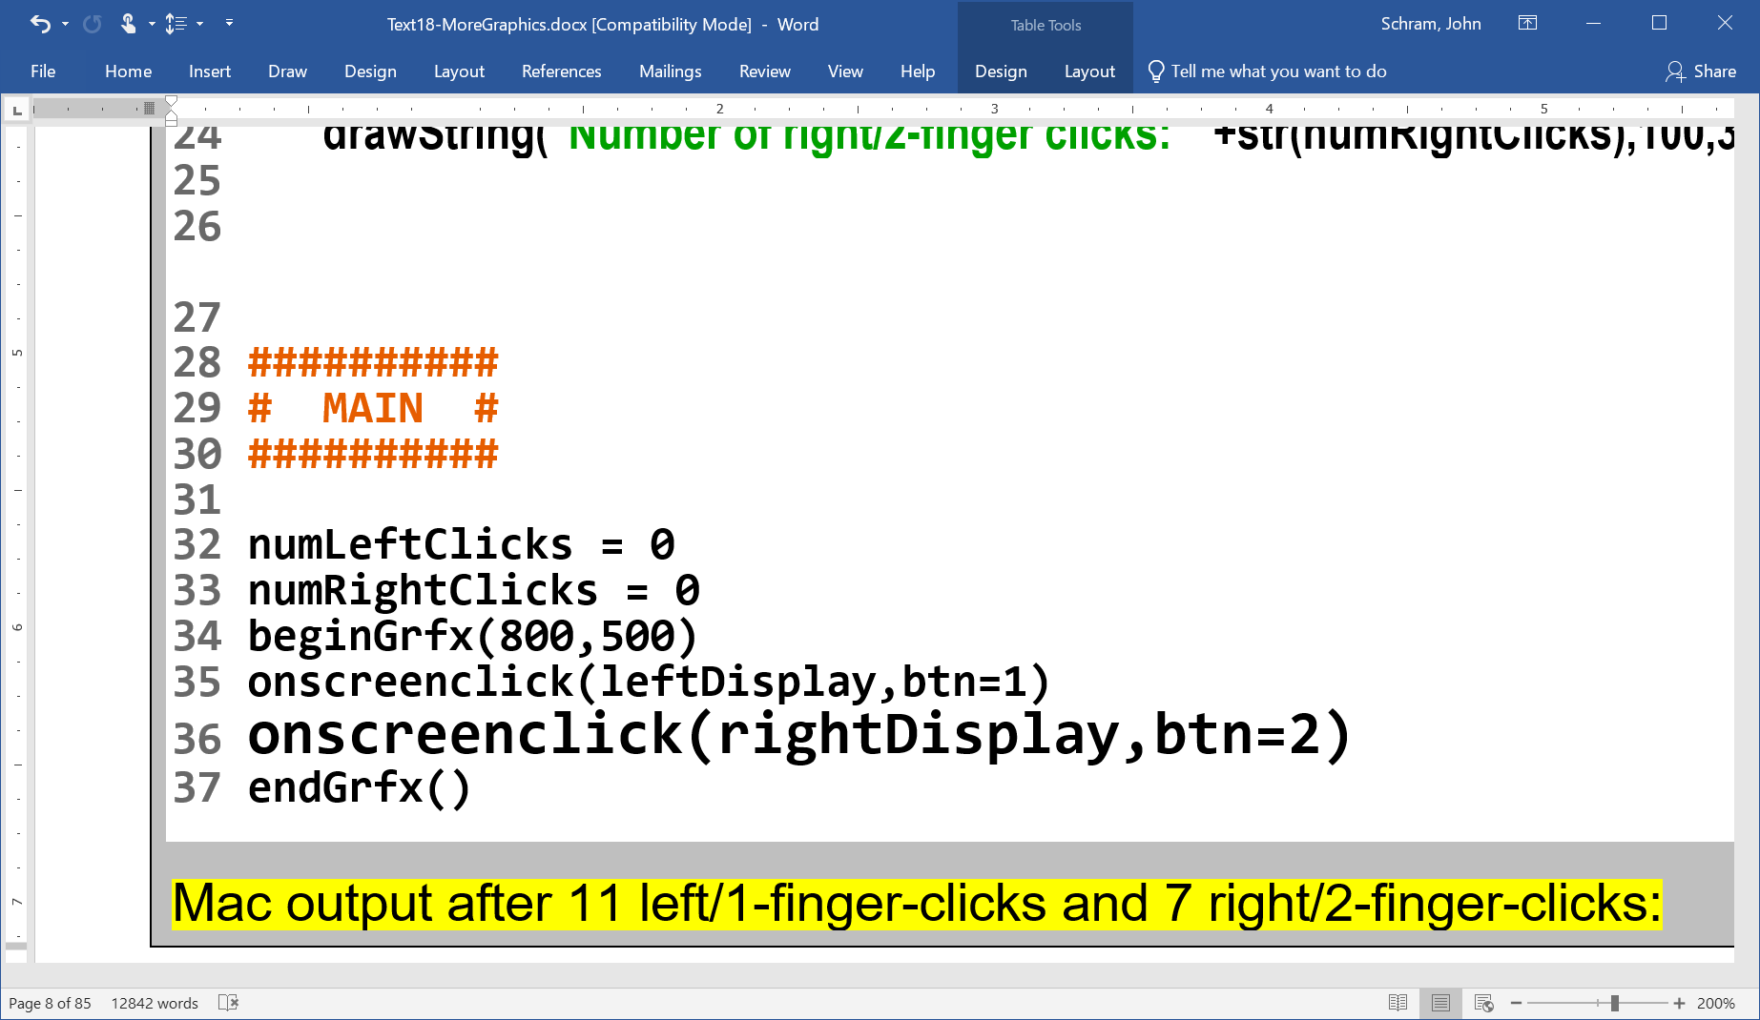
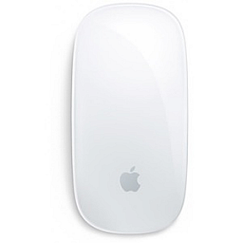
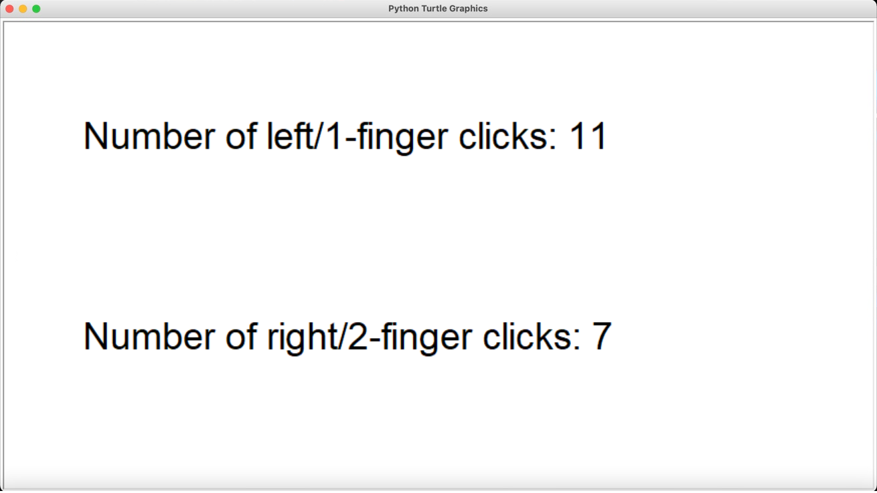

x11 x7
This Photo by Unknown Author is licensed under CC BY-SA

Slide 12
Determining the
Operating System

Slide 13
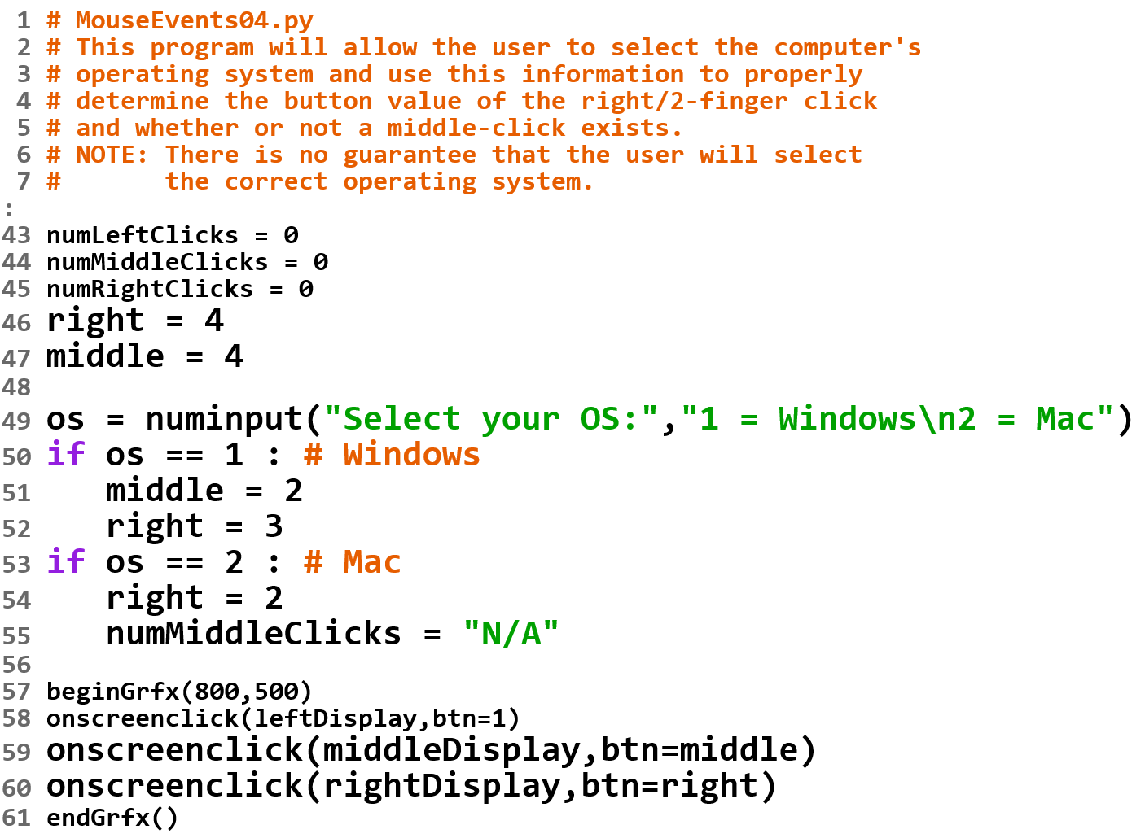

Slide 14
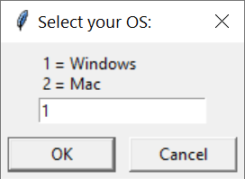

Slide 15
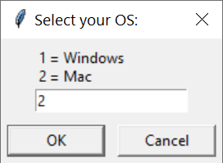
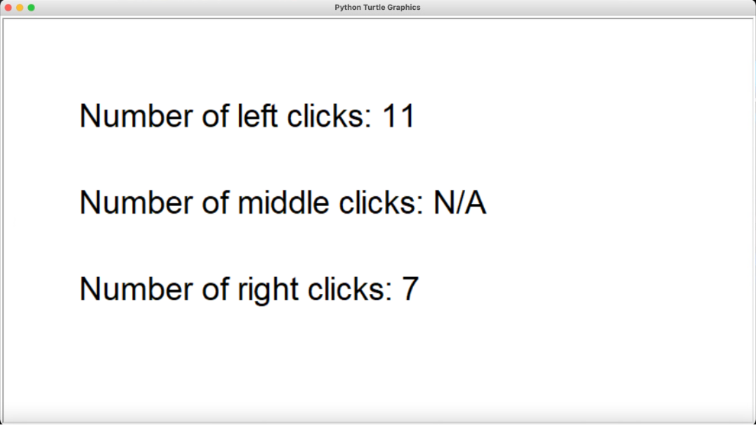

Slide 16
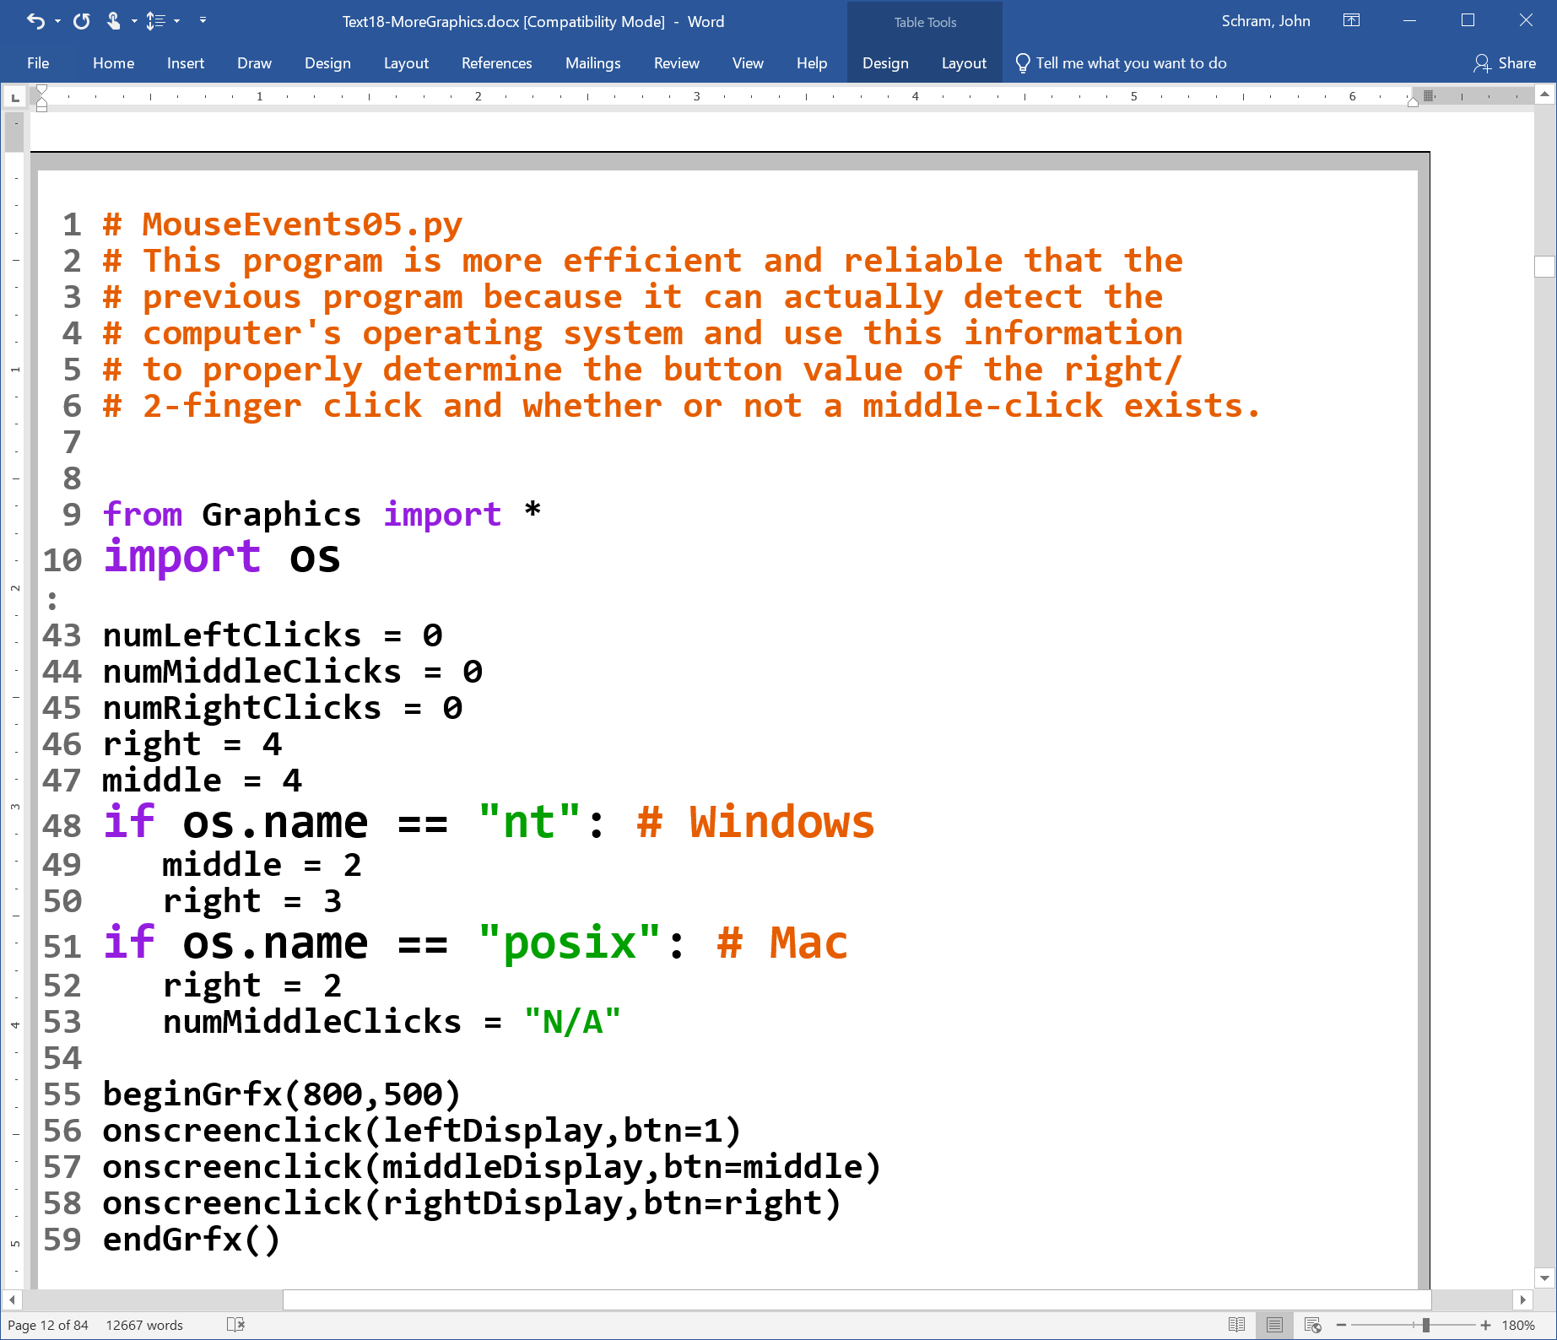

Slide 17
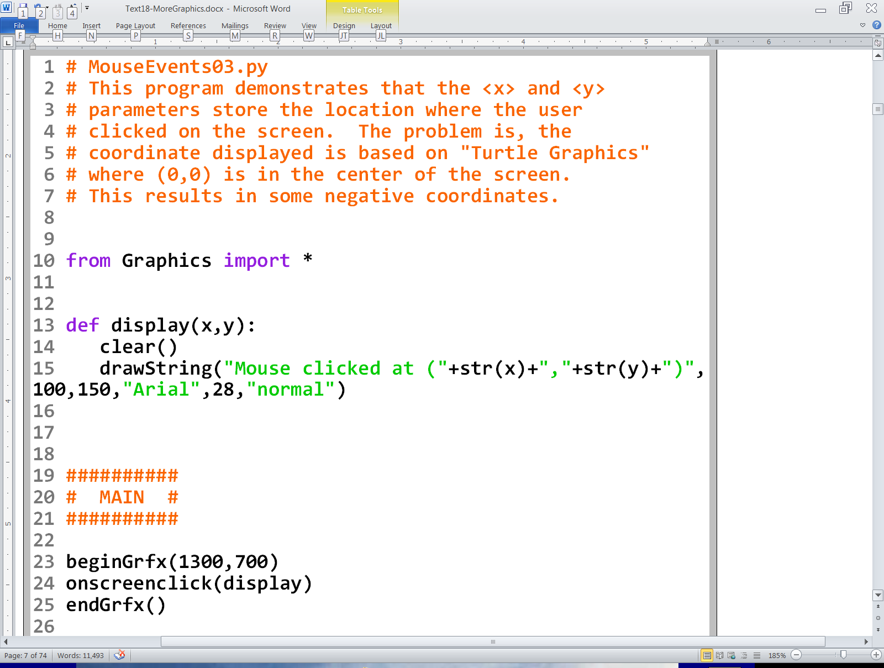
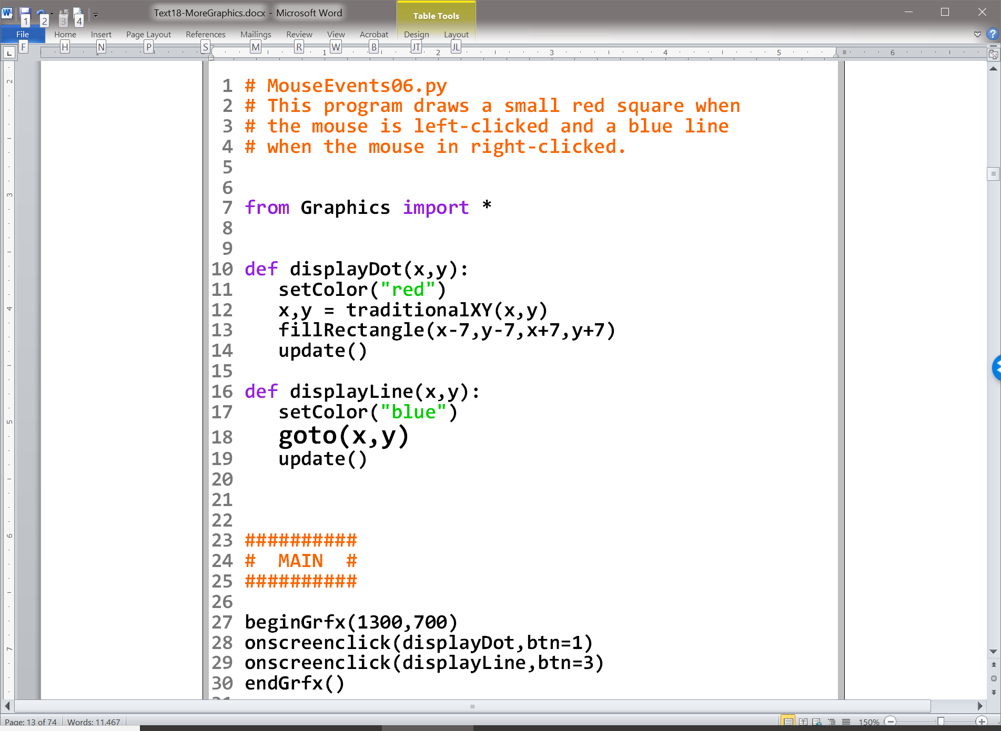

Slide 18
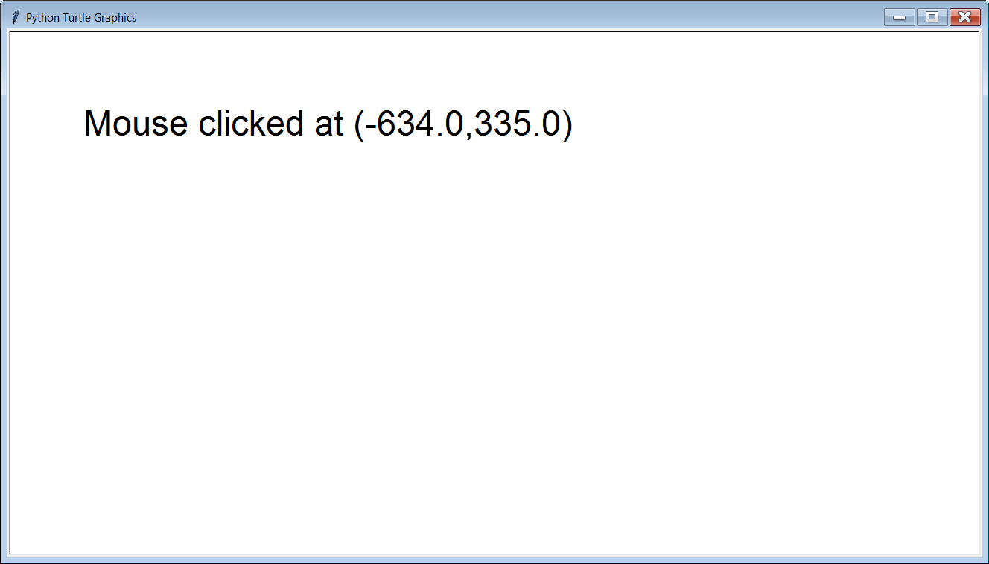
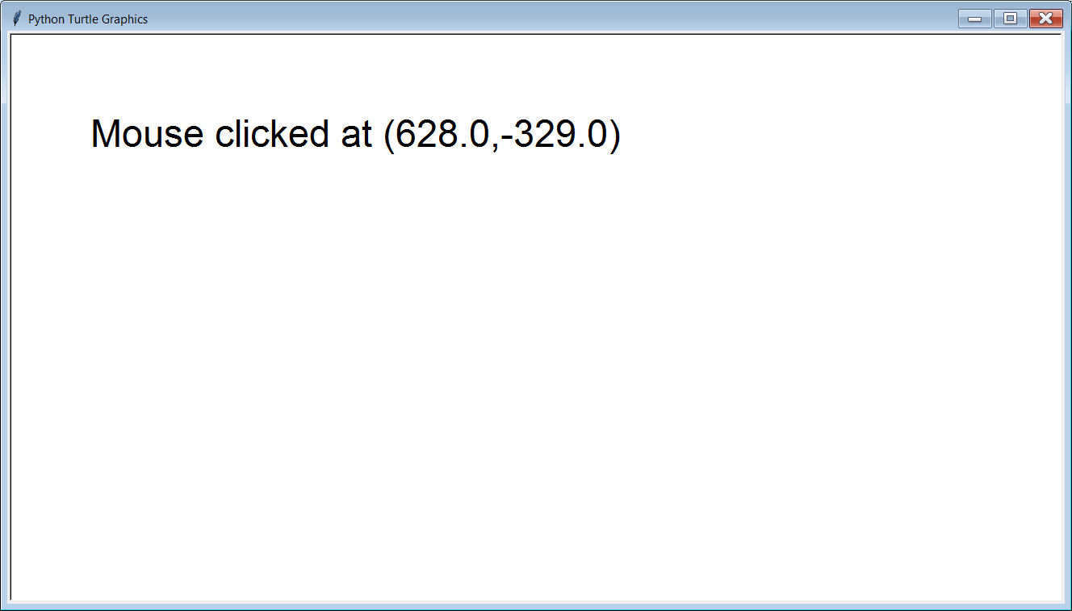

Slide 19




Slide 20
The coordinate returned is based on the coordinate system used by Turtle Graphics where (0,0) is in the center of the window. Any y values below and x values to the left will be negative as the outputs show.

Slide 21
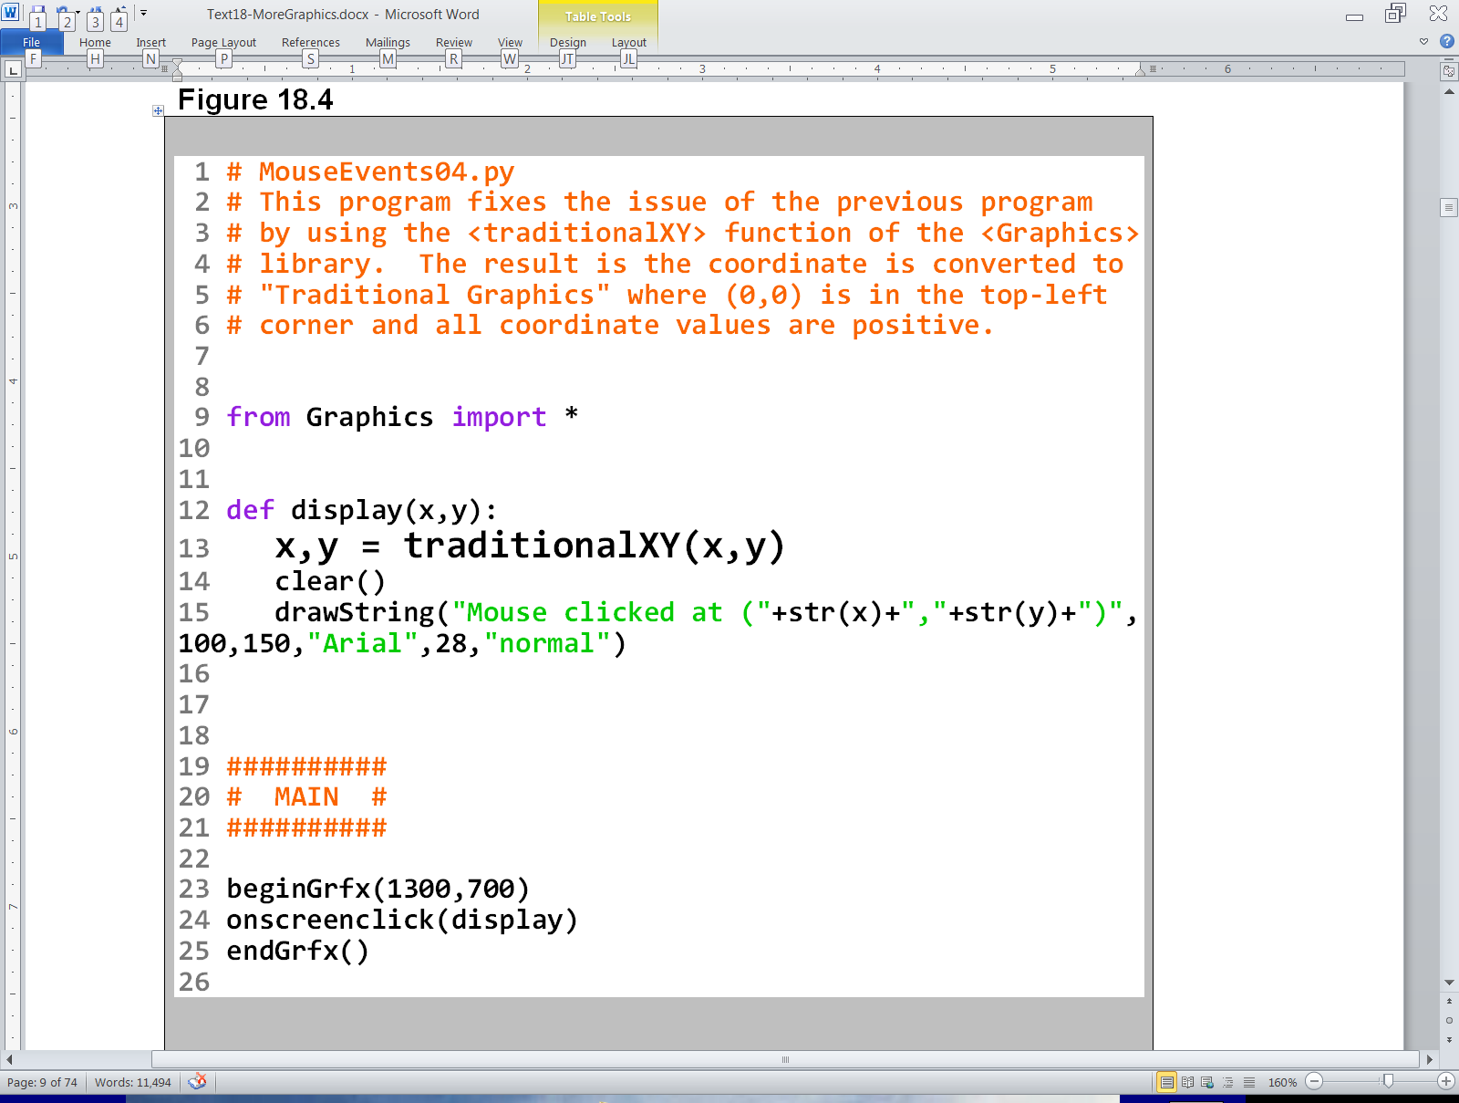
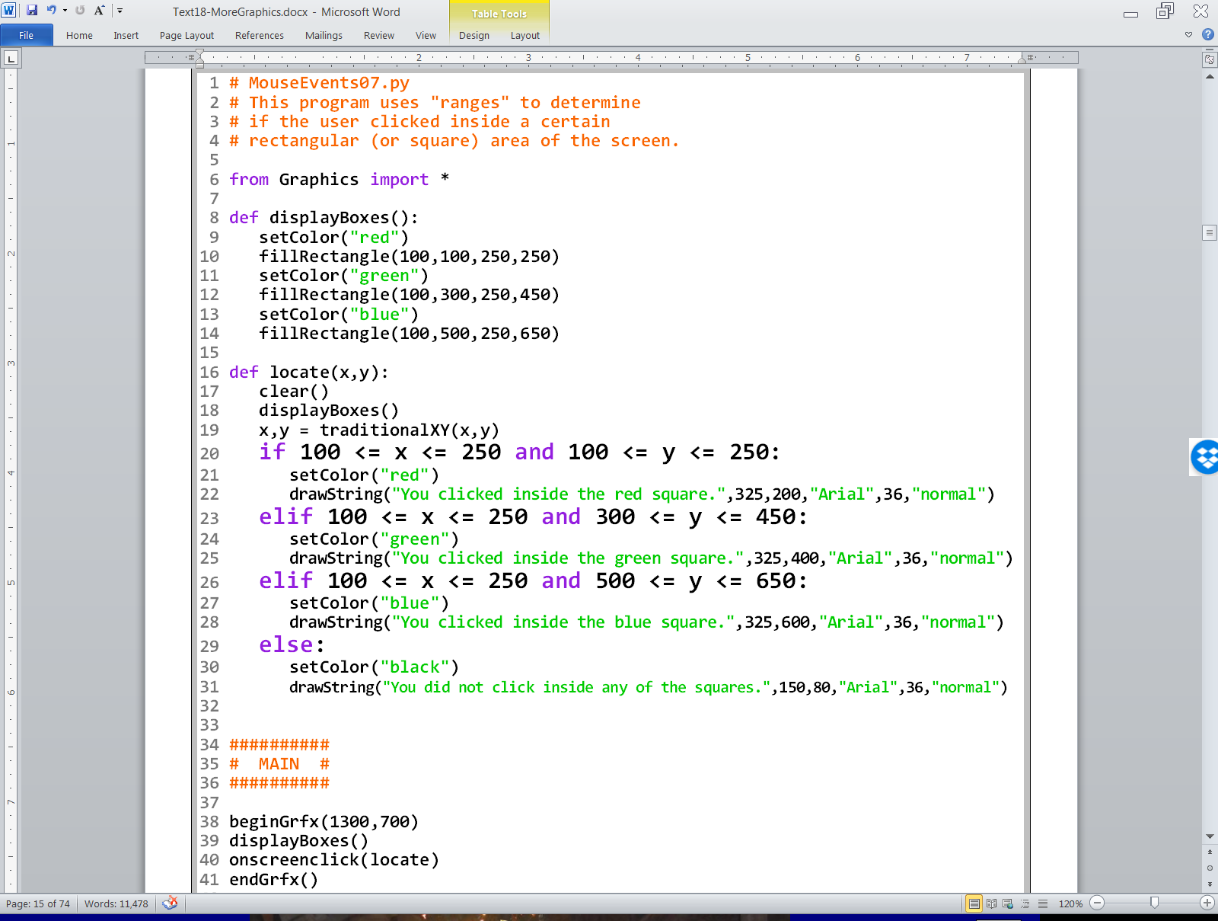

Slide 22
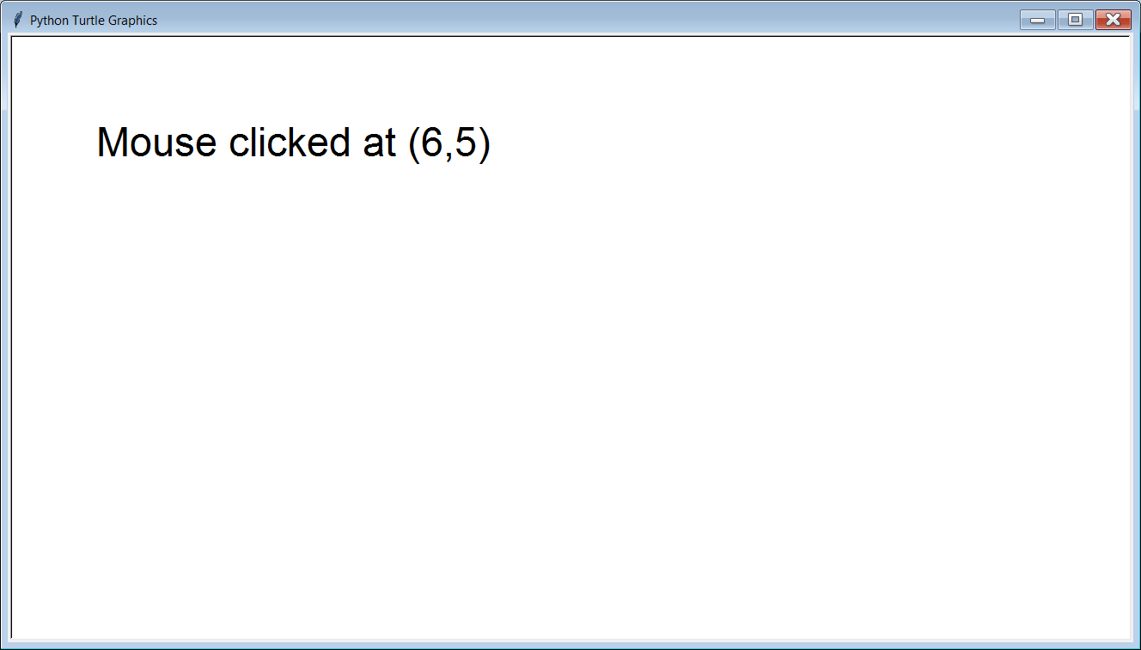
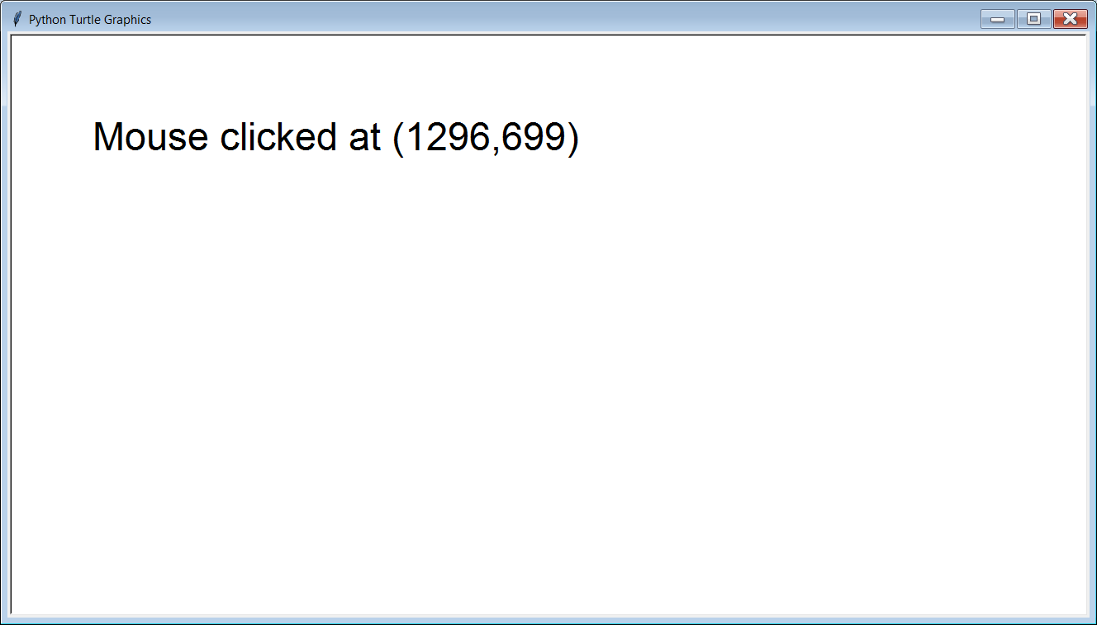

Slide 23
Section 18.3
Creating Simple
Paint Program Tools

Slide 24
Paint Program Tools vs. Entire Paint Program
We are not creating an entire paint program.
That assignment will have to wait for the Advanced Graphics class.
In this class, we are merely introducing some concepts by creating some of the simpler tools from a paint program.
This will lead into Lab 18A.

Slide 25
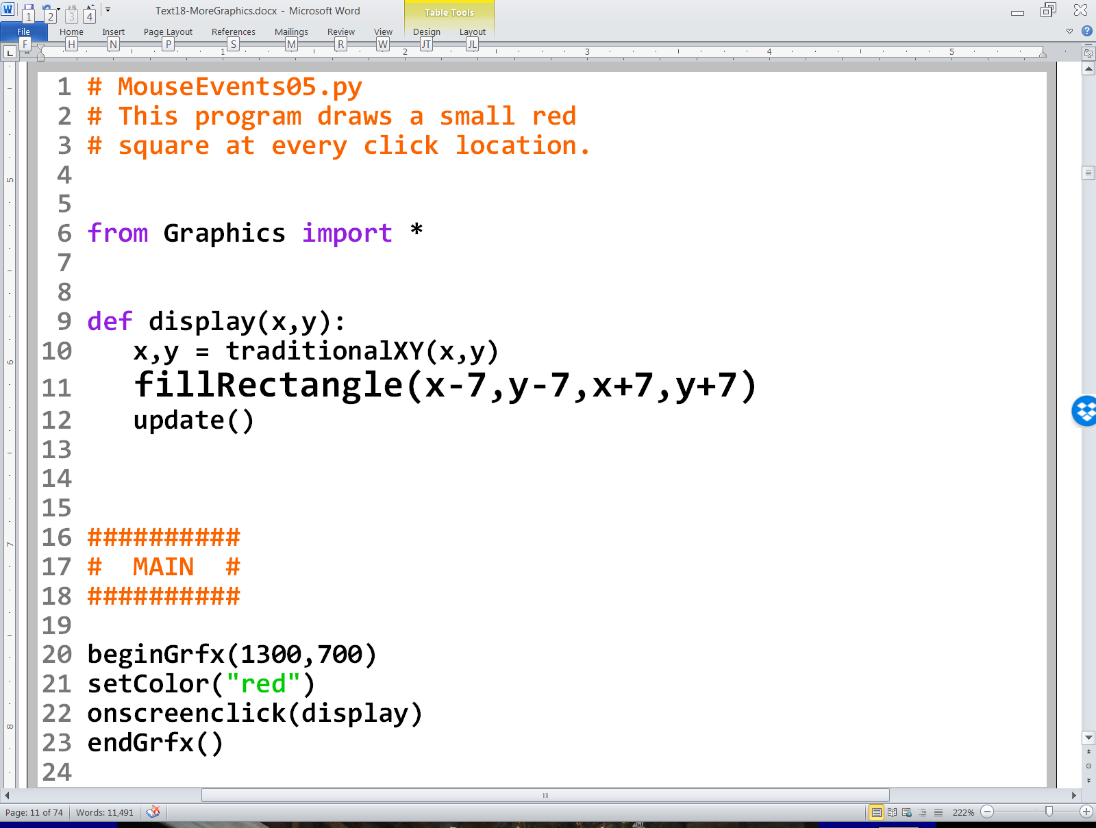
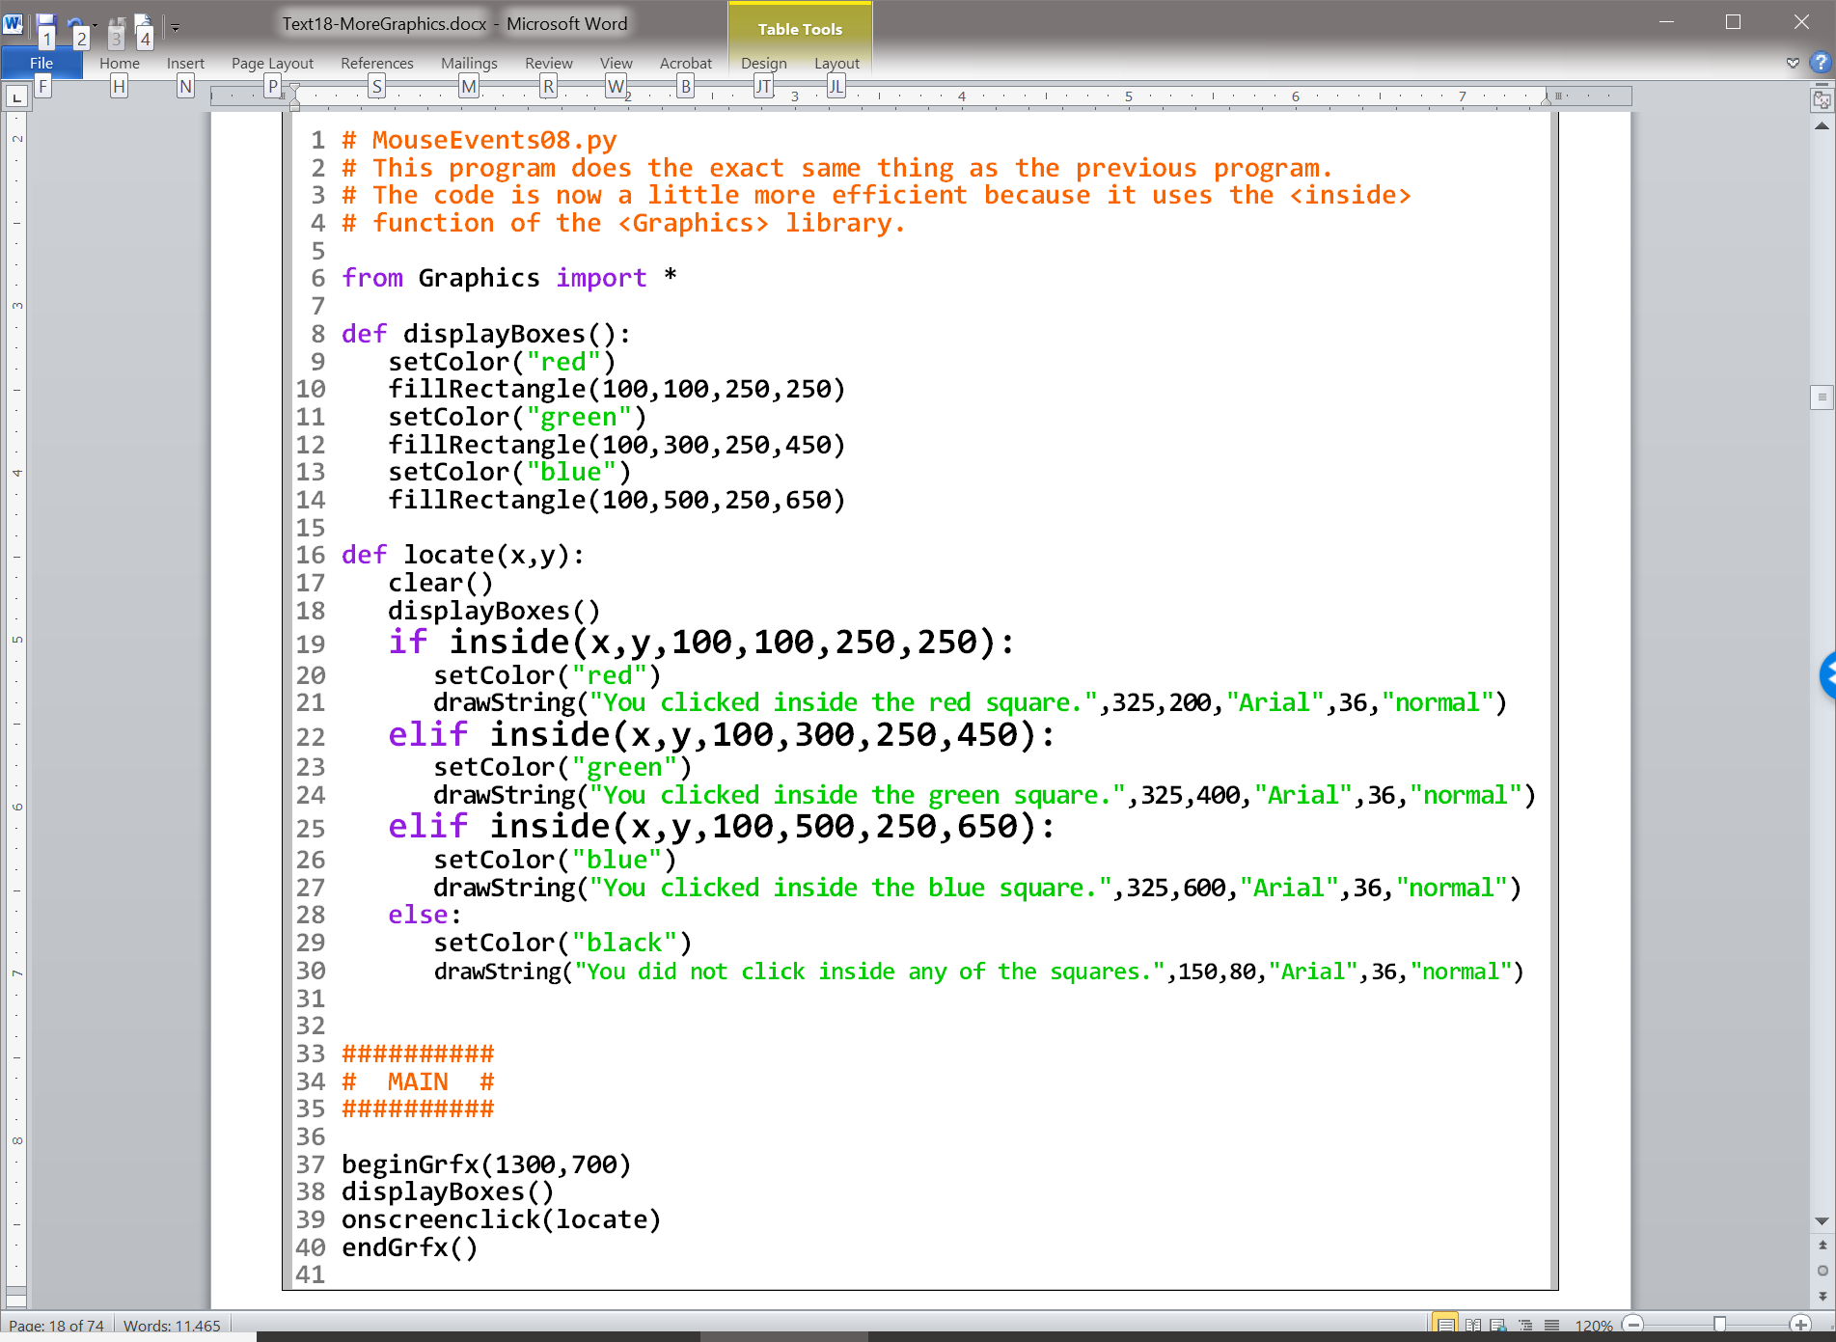
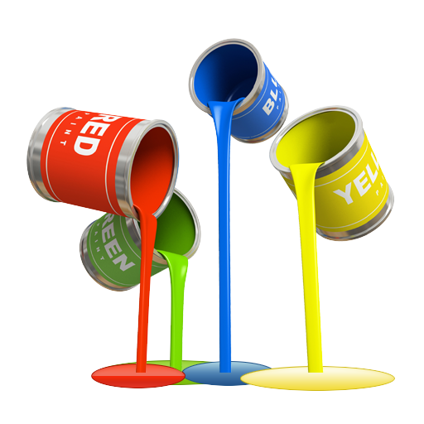

Slide 26
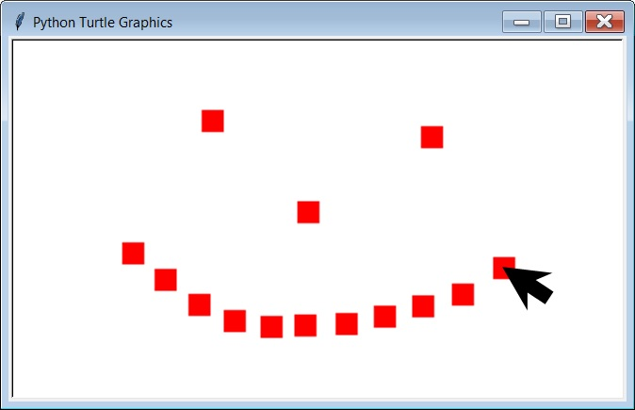

Slide 27
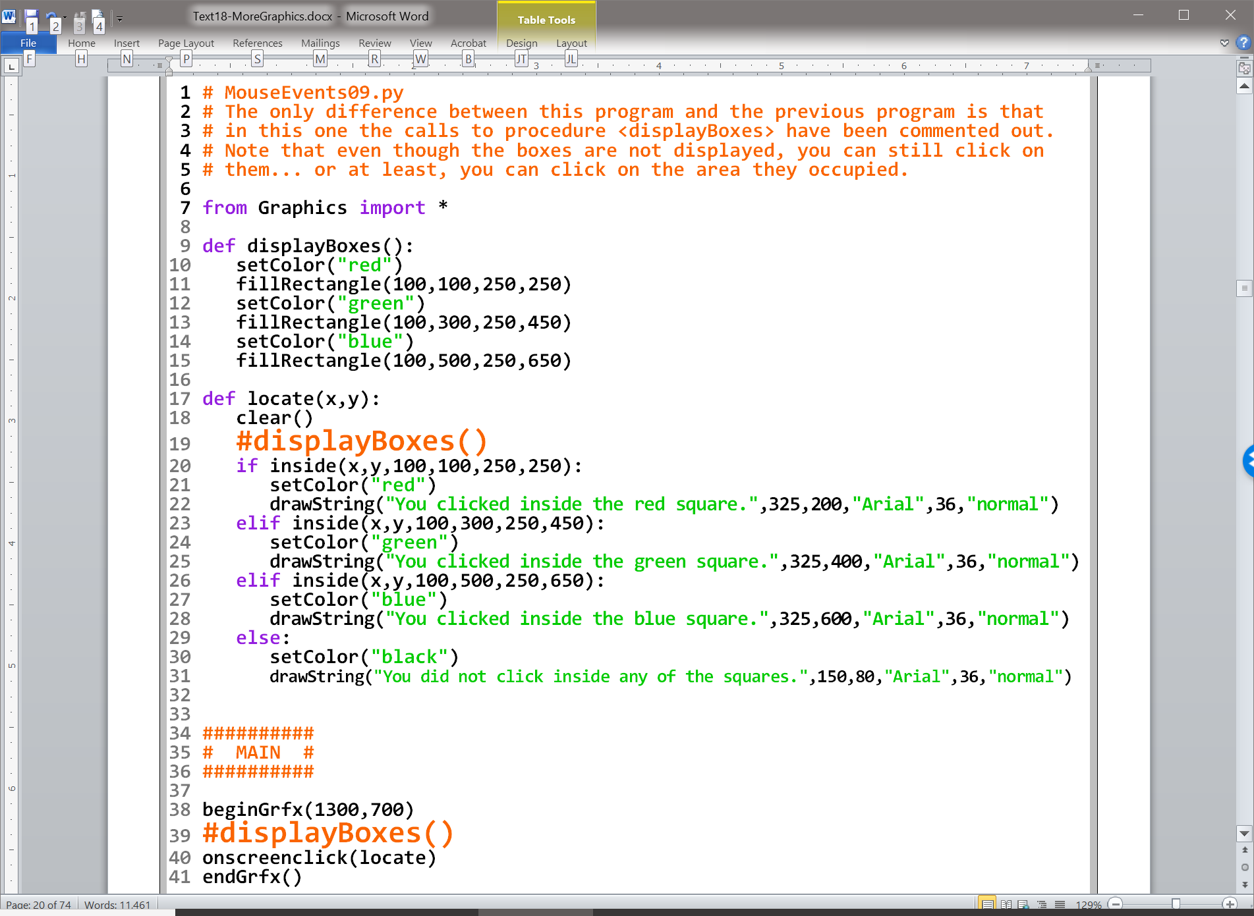

Slide 28
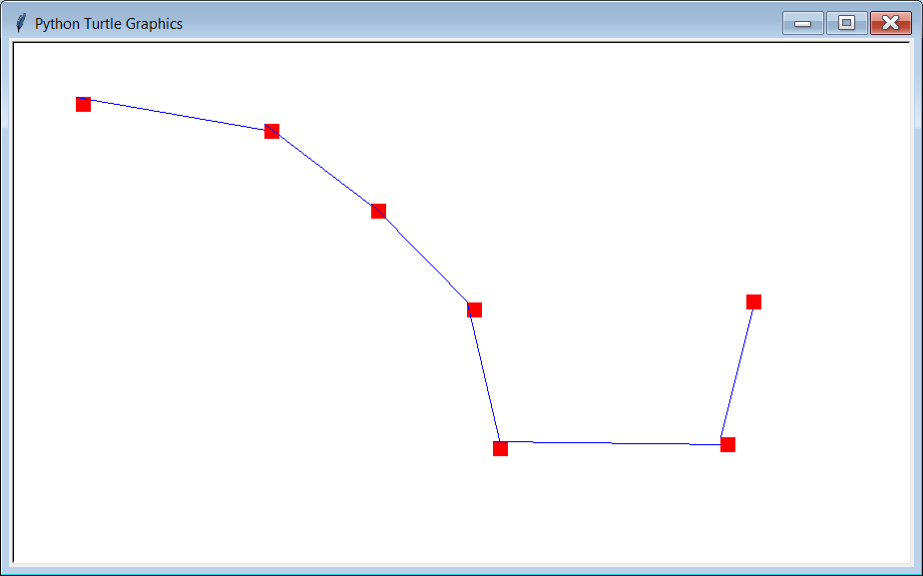

Slide 29
Unlike drawLine, with goto, you only specify the end point. The start point is simply the last coordinate that was used. If the program has just started, the start point is (0,0). Also, goto uses the coordinates from Turtle Graphics, so no conversion is necessary.

Slide 30
Section 18.4
Creating
Clickable Areas

Slide 31
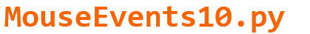

Slide 32
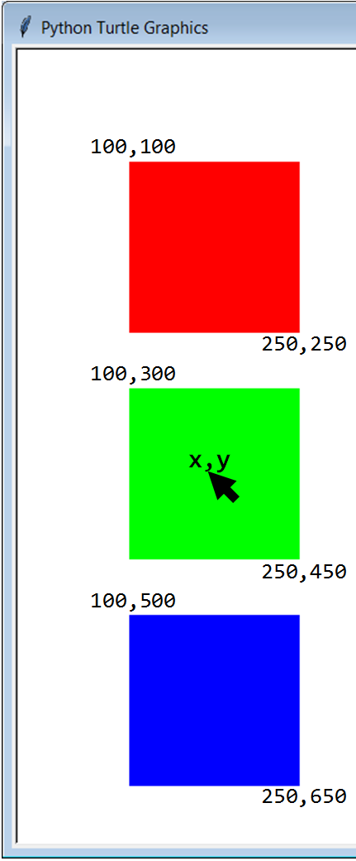

Slide 33
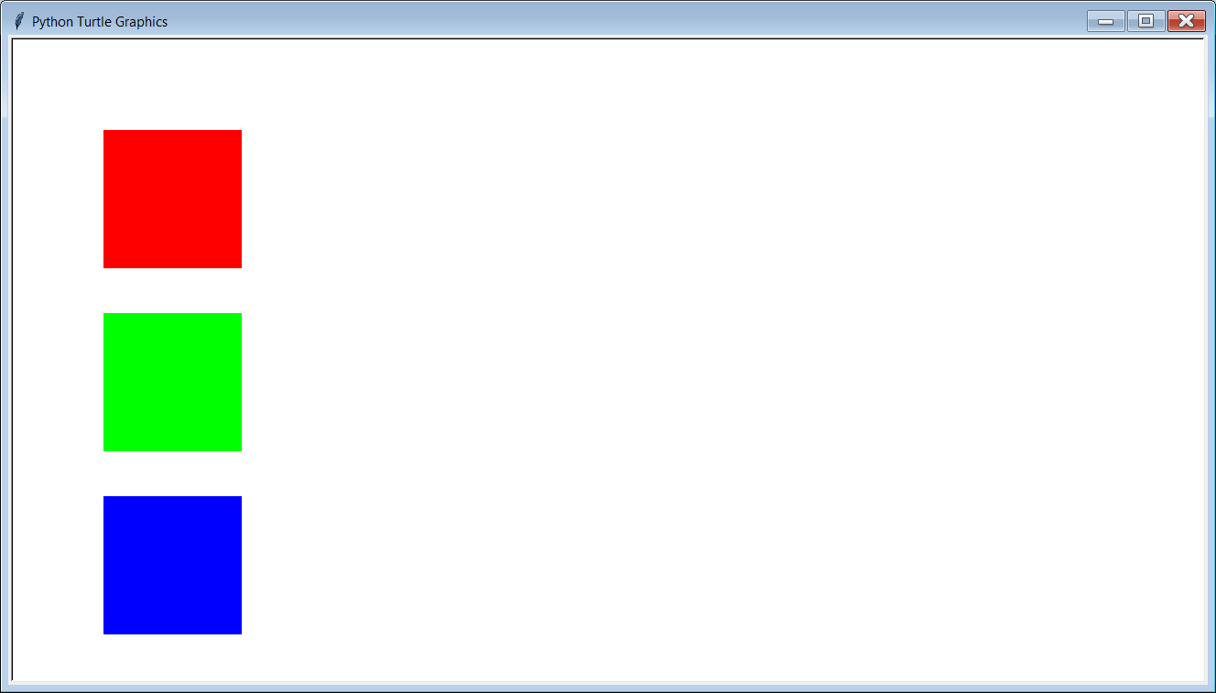
Initial Output

Slide 34
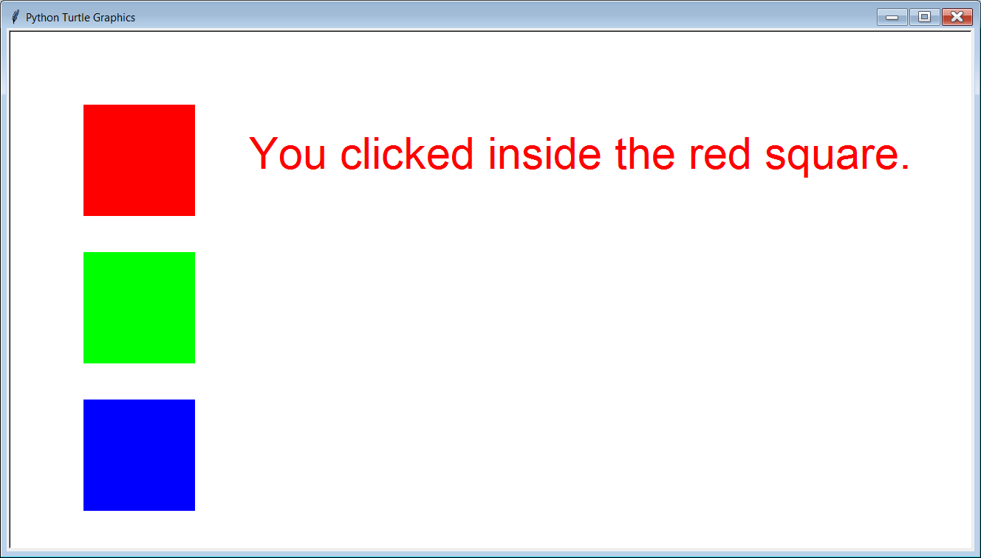

Slide 35


Slide 36
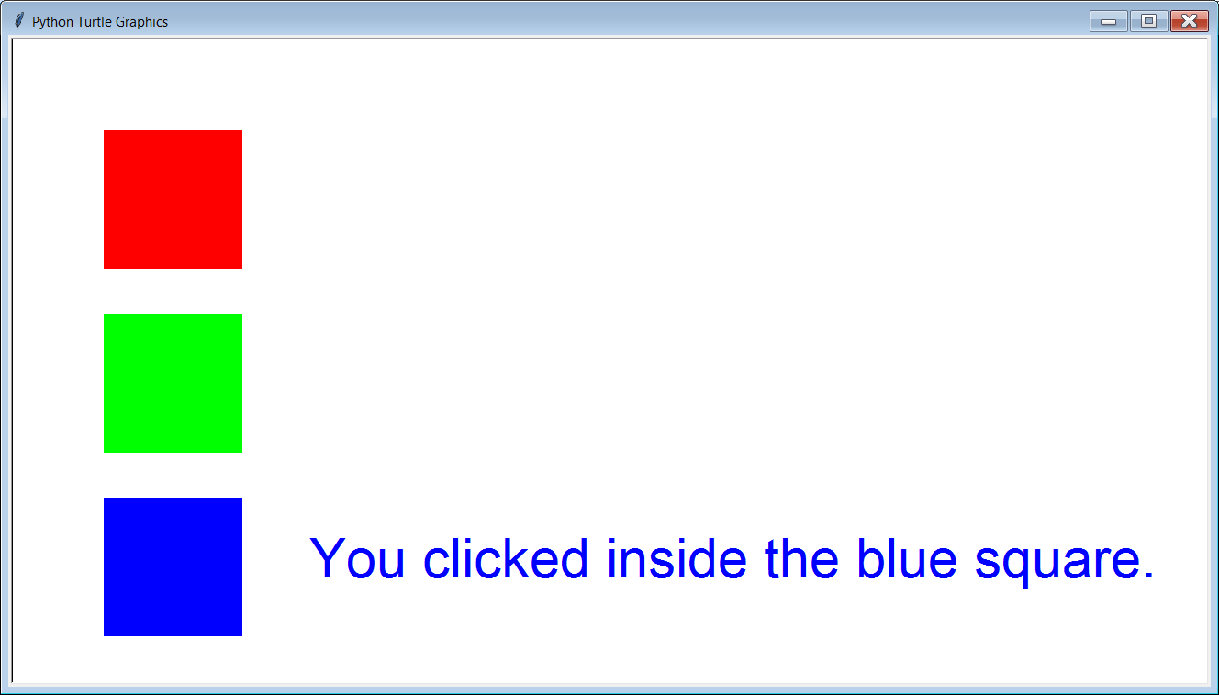

Slide 37
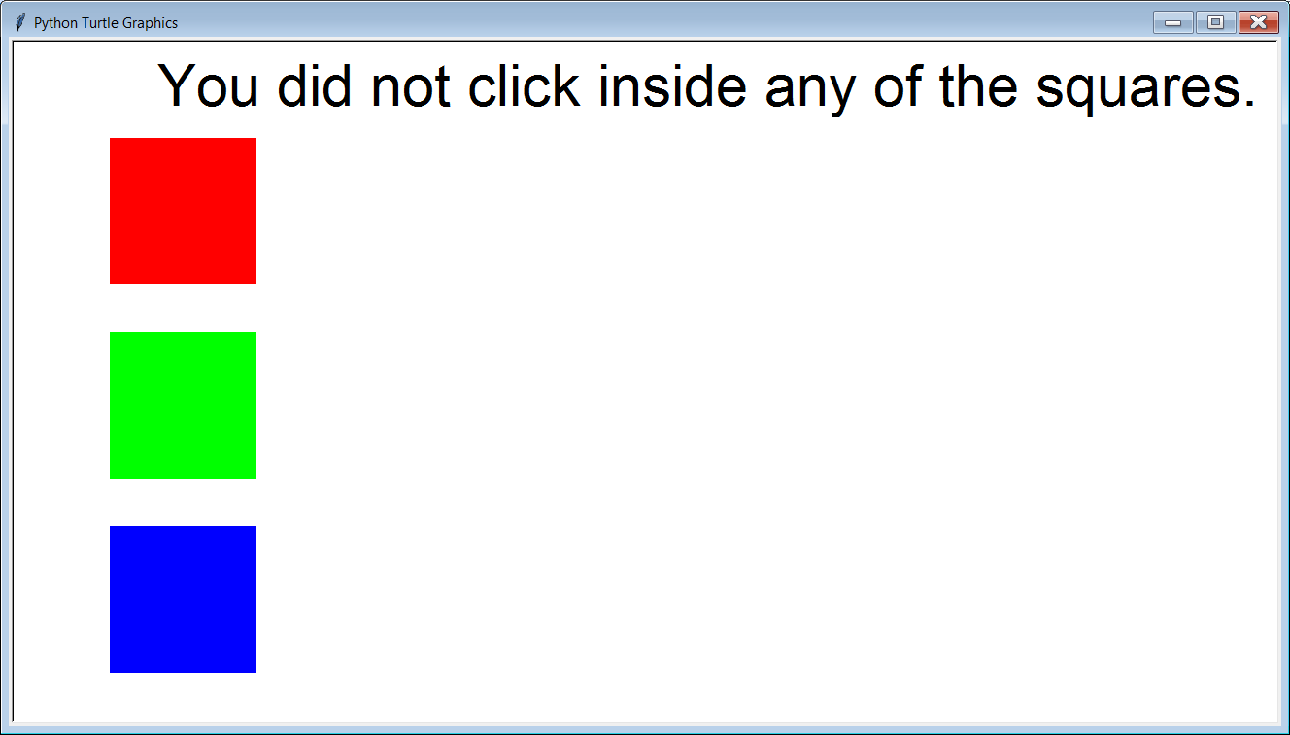

Slide 38
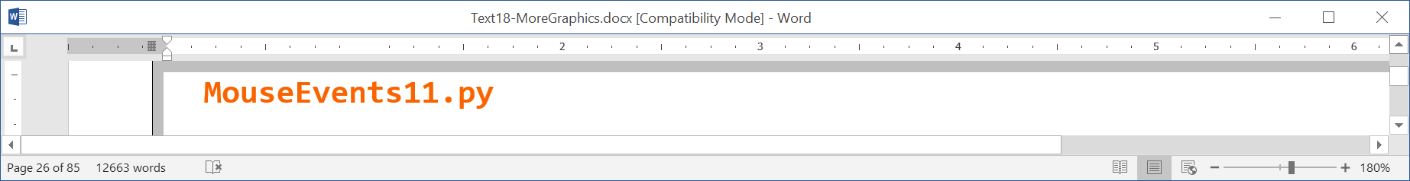

Slide 39
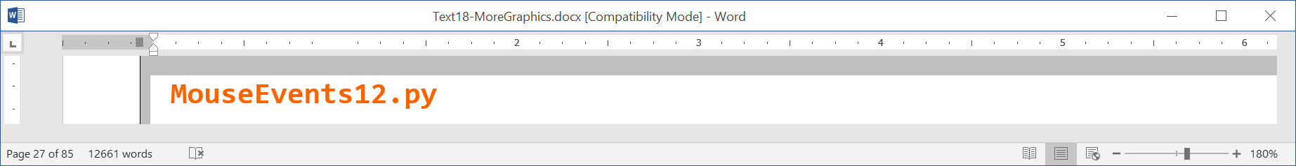

Slide 40
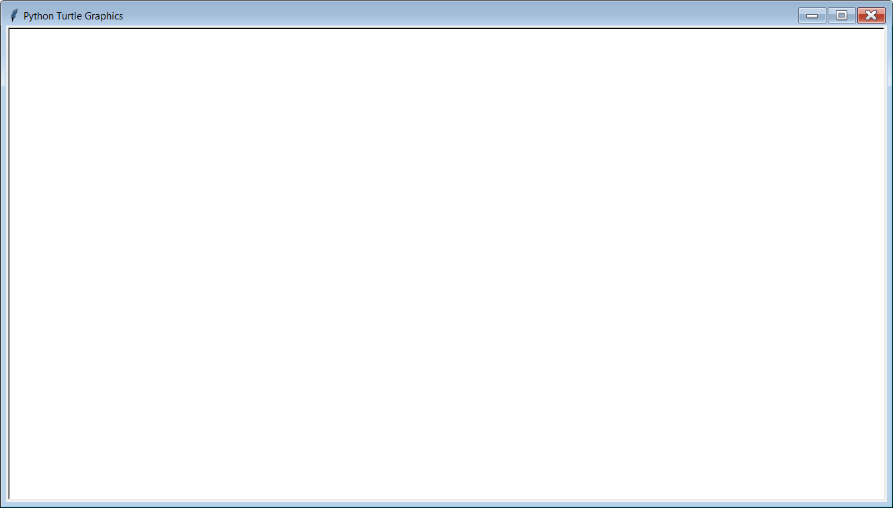
Initial Output

Slide 41
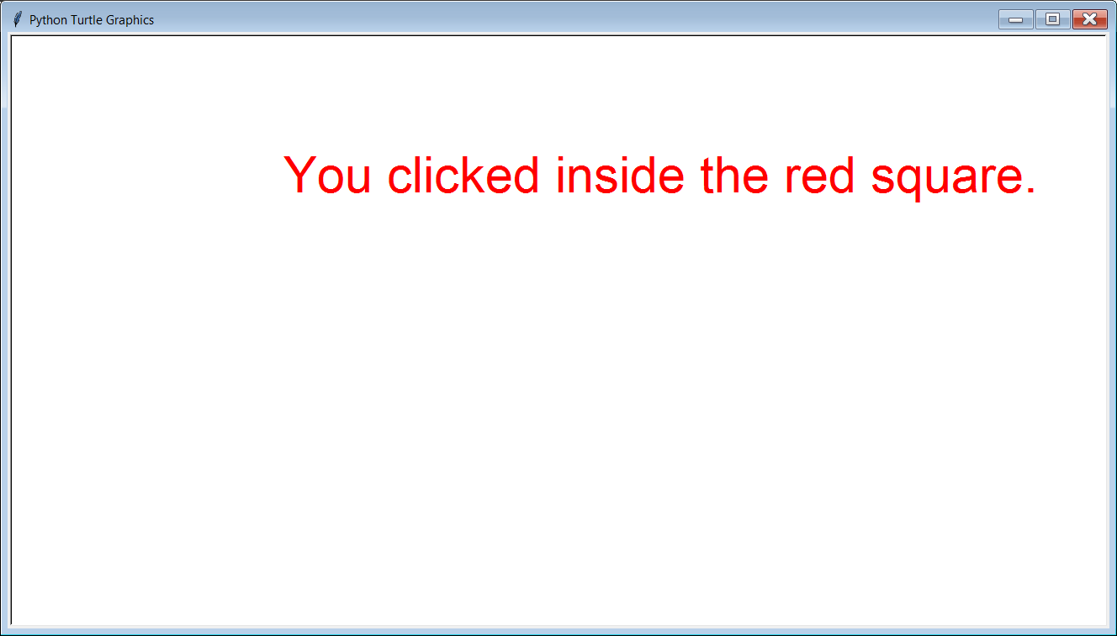

Slide 42
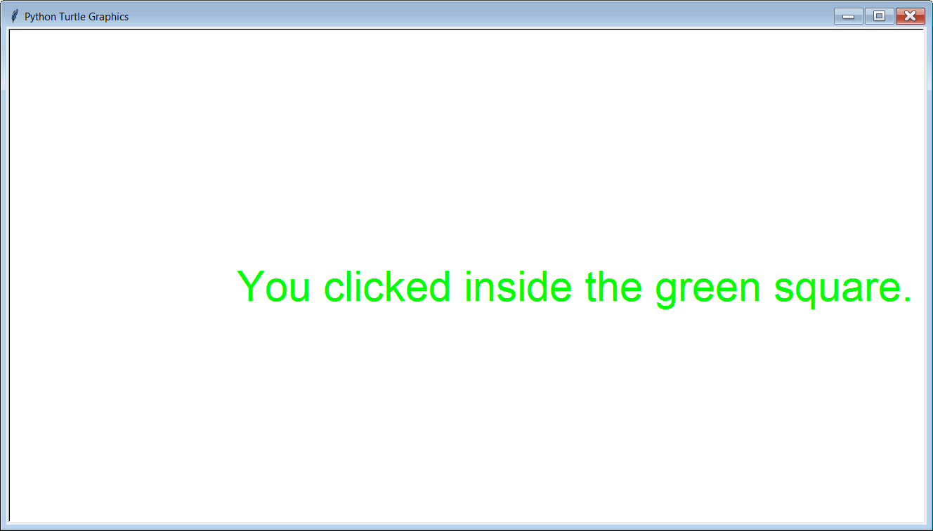

Slide 43
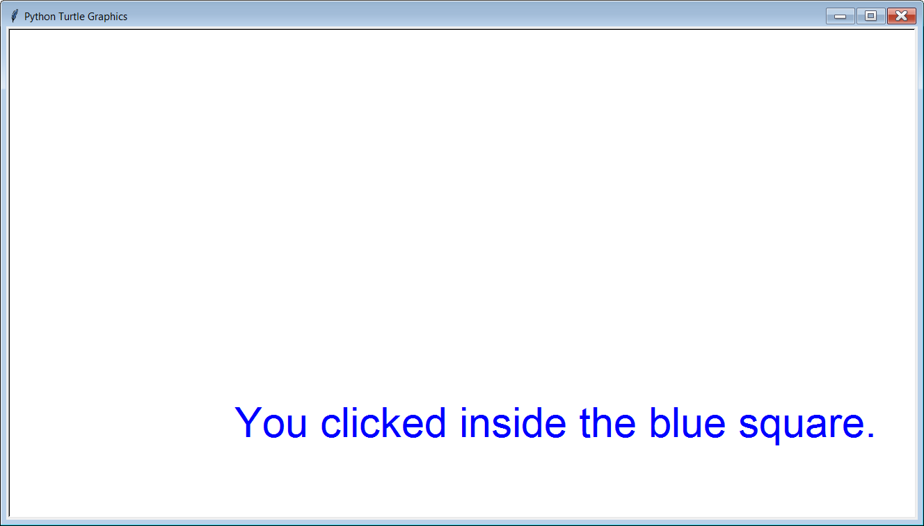

Slide 44
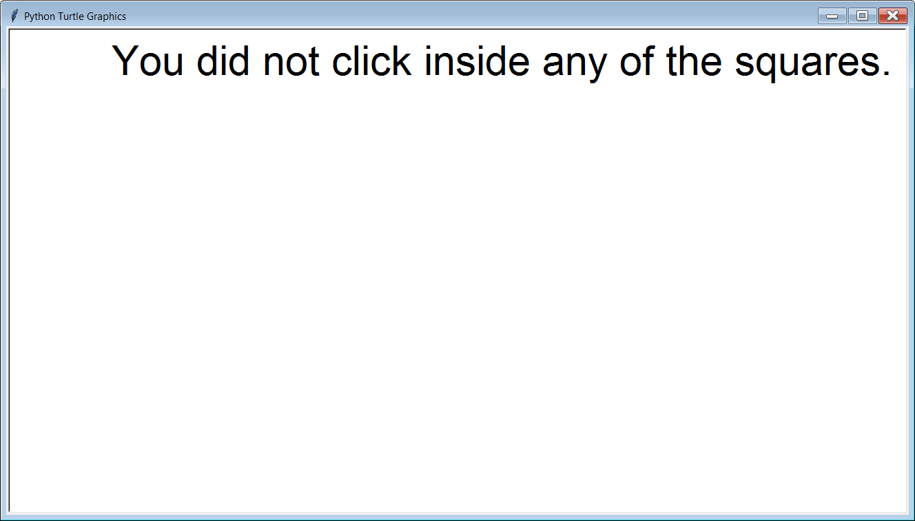

Slide 45

Section 18.5
Key
Events

Slide 46
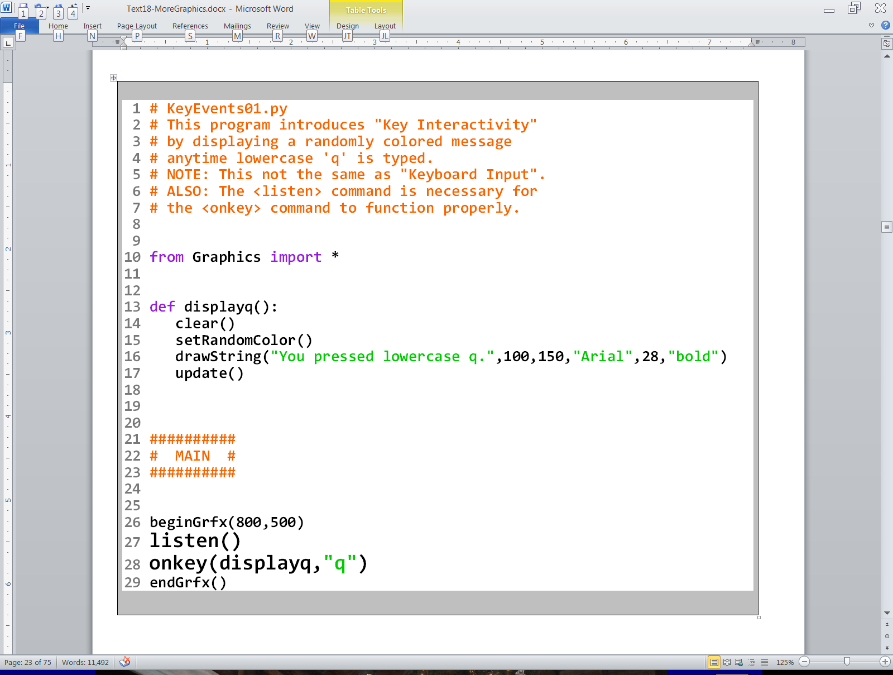

Slide 47
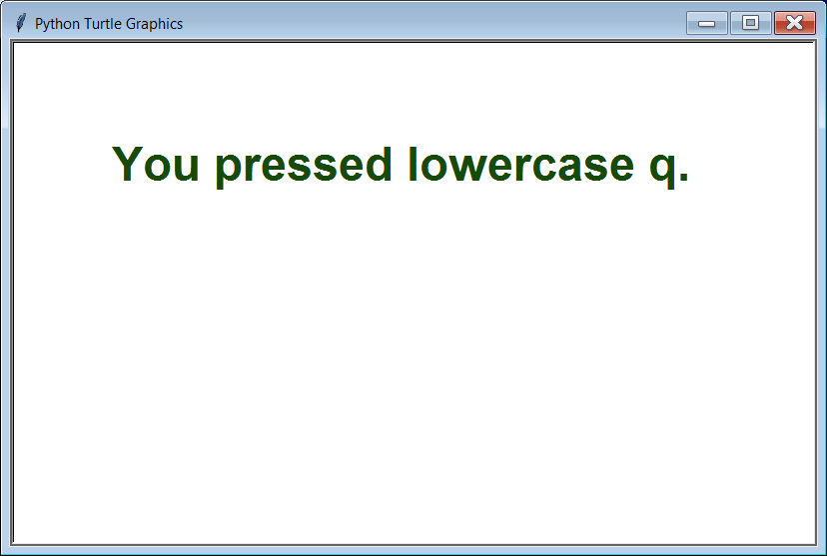

Slide 48


Slide 50


Slide 51




Slide 52


Slide 53




Slide 54


Slide 55


Slide 56


Slide 57


Slide 58


Slide 59


Slide 60

Output after
ANY key is pressed

Slide 61

Output after the
<space bar> is pressed

Slide 62











Section 18.6

Slide 63



Slide 64


Slide 65


Slide 66




Slide 67
Windows PC Output:
The circle did move
across the screen,
but it happened
so fast your eyes
did not have
a chance to see it.

Slide 68

Mac Output:
On a Mac, the circles
are not completely erased.

Slide 69




Slide 70


Slide 71


Slide 72


Slide 73


Slide 74


Slide 75


Slide 76


Slide 77


Slide 78


Slide 79


Slide 80


Slide 81


Slide 82


Slide 84

Program Note
The output of program Animation04.py was simulated with PowerPoint.
It will not be possible to simulate the
output of the remaining programs.
You need to execute them on
your own computer to truly
see what they are doing.

Slide 85

Do you see a
pattern here?

Slide 86


Slide 87


Slide 88


Slide 89






Slide 90






Slide 91


Slide 93


Slide 94




Slide 95


Slide 96


Slide 97



Slide 98


Slide 99



Slide 100



Slide 101


Slide 102



Slide 103


Slide 104
Draw-And-Redraw Animation Step-By-Step Review
1. Clear the screen.
2. Draw the entire background
(preferably by using a procedure).
3. Draw the foreground image.
4. Delay for a fraction of a second.
5. Repeat this process over and over each time drawing
the foreground image in a slightly different location.
This is the recommended approach for Computer Animation in our class because it solves BOTH of the problems of Draw and Erase Animation:
It works even if your background is not one solid color.
2. The animation will not slow down, even for complicated images.

Slide 105
Section 18.7
The Last Word

Slide 106
Programming Knowledge Never Becomes Obsolete
Some people may be concerned that with technology changing so rapidly, the programming knowledge that they have acquired in this course will soon be out of date. While new programming languages pop up from time to time, the logic of programming has never changed.
The next 6 programs all do the exact same thing:
The 1st is written in Python. The 2nd is in Java. The 3rd is in C++. The 4th is in Pascal; the 5th is in BASIC; and the 6th is written in VEXcode VR Blocks. Even though you may have never seen some of these languages before, you may be surprised how familiar these programs will look to you now that you know Python.

Slide 107


Slide 108


Slide 109


Slide 110


Slide 111


Slide 112


Slide 113


Slide 114


Slide 115



Slide 116





